Slide 1
Road to Copilot: Adottare l’AI nel Modern Workplace
Roberto Freato
CTO @Retex | Author | Azure MVP

Slide 3
20 years of (some) innovations
Internet of Things (2012-2020)
Quantum Computing (2010-2022)
Big Data Analytics (2010-2018)
Blockchain & Crypto (2008-2020)
Smartphones (2007-2015)
Cloud Computing (2006-2015)
Social Media Platforms (2004-2012)
2004
2009
2014
2019
2024

Slide 4
20 years of (some) innovations
GenAI (2022-)
Internet of Things (2012-2020)
Quantum Computing (2010-2022)
Big Data Analytics (2010-2018)
Blockchain & Crypto (2008-2020)
Smartphones (2007-2015)
Cloud Computing (2006-2015)
Social Media Platforms (2004-2012)
2004
2009
2014
2019
2024

Slide 6
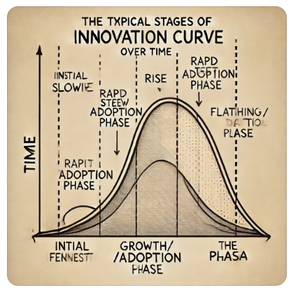
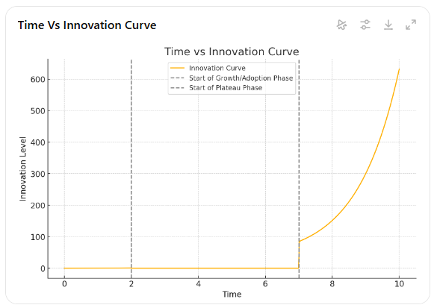
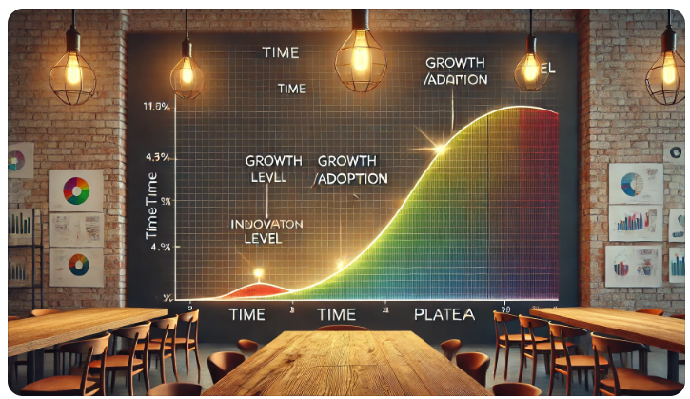
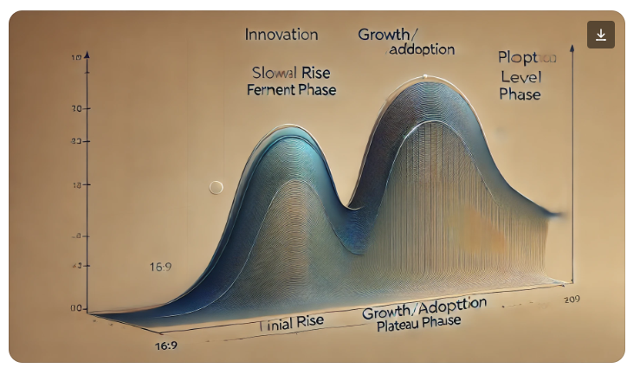

Slide 7
Smartphones (2007-2015) ~ 9 years
2012
Cloud Computing (2006-2015) ~ 10 years
2013
GenAI (2022-2024) ~ 2 years
2025-2026?

Slide 8
“L'Anello L’AI concede al portatore un potere proporzionale a quello che già possiede”
J. R. R. Tolkien
Me
* Questa affermazione si basa su ricerche reali che suggeriscono che l'IA può amplificare sia gli esiti positivi che quelli negativi. Tuttavia, non ho i diritti per condividerla qui

Slide 9
“L’AI generativa è, per la maggior parte di noi, ciò che Excel era per i contabili negli anni '90.”
* Questa affermazione non si basa su nulla

Slide 10
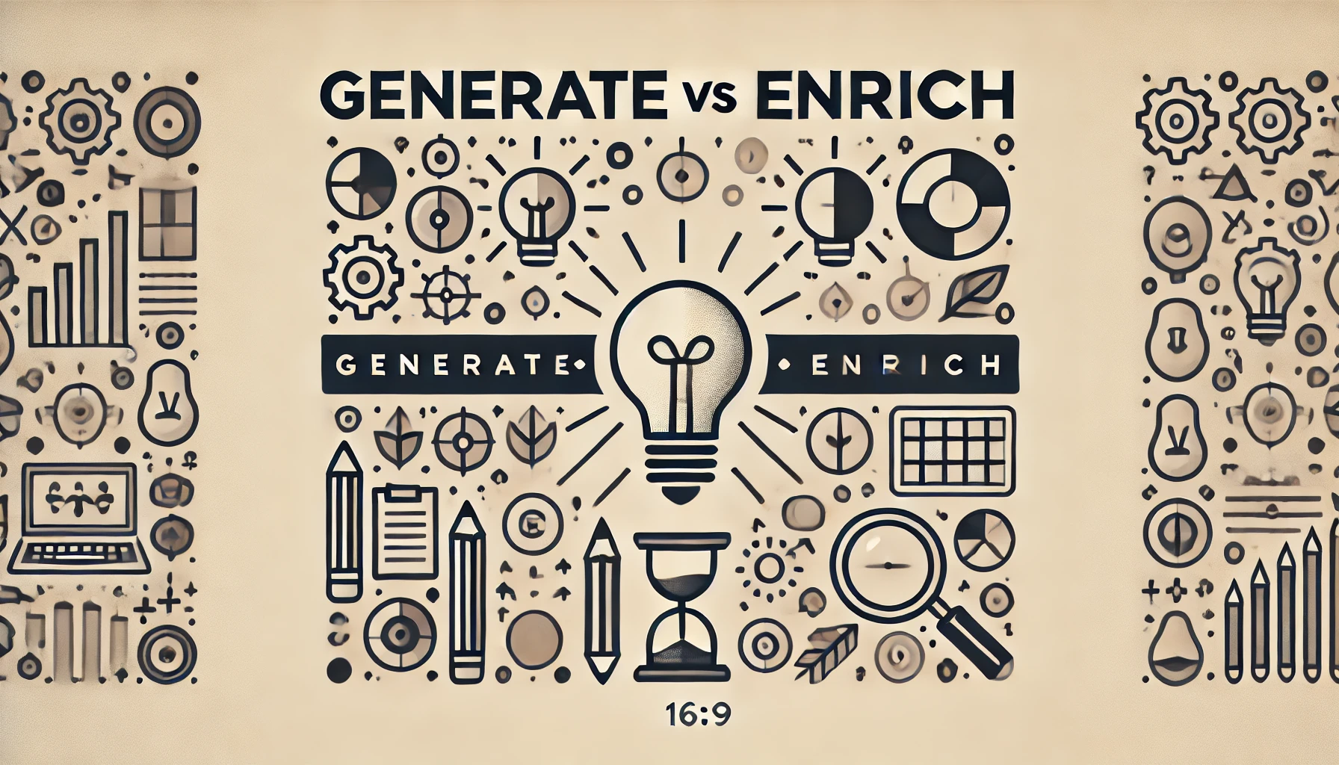

Slide 11
Statement
Con l’AI generativa, non dovremmo sforzarci di capire come confezionarla e venderla come un prodotto—questo è stato un errore comune nell'ultimo anno e mezzo. Invece, dobbiamo diventare i suoi principali utilizzatori il più rapidamente e ampiamente possibile. Più la integriamo nel nostro lavoro quotidiano—proprio come usiamo Excel, smartphone o anche una scrivania e un mouse—più naturalmente emergeranno le idee giuste per nuove offerte e prodotti. Queste innovazioni potrebbero non ruotare necessariamente intorno all’AI stessa ma, senza di essa, potrebbero non vedere mai la luce.

Slide 12
Proposal

Slide 13
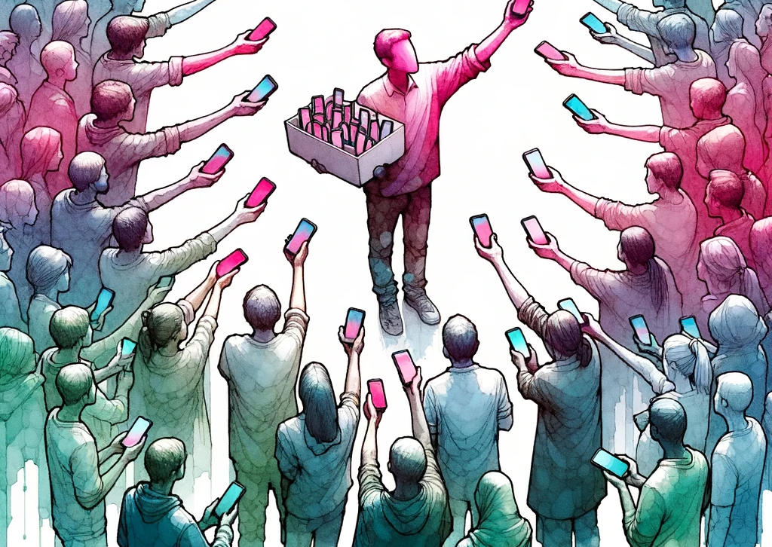
Empower

Slide 14
Let’s give GenAI to every colleague
Challenges
  Costs:
    current price point for a user/month for a GenAI tool is 10-40$/m
  Vendor lock-in:
    with this speed, who’s the market leader, 6 months from now?
  Security:
    does the paid solution provide 100% safety and privacy to our data?
  Control:
    can we shape the service features to both address results and evangelization?

Slide 15
The tech part

Slide 16
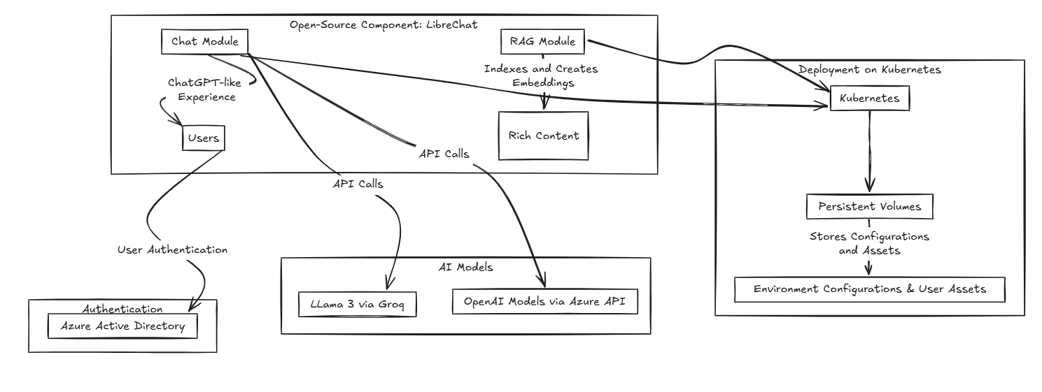

Slide 17
DEMO
Basic generation, Prompt libraries, Settings, RAG, Models comparison
Notes:
Recap the file
I'm attaching a file and you read it. I want you to help me understanding the contents by summarizing it.
I want the result as {{style: bullets, sentences}}. If you ask me if use some bold/italic/underline styles to emphasize? I would say {{emphasis: yes , no}}.
Use {{language}} for the output.
Be {{lenght: short, wordy, verbose}}.

Slide 18


Slide 19
compute quadrant (2022)
Container Apps
Notes:
Budget – 5min
How to read this quadrant and how’s made
Information is accurate but personal
Scale may depends on soft or hard limits of the platform
Examples of soft and hard limits
Ease of management can be the degree of interest we need to have to the underlying infrastructure
Or either the lock-in aspect
Or the industry-standard adherence

Slide 20
compute quadrant (now)
Container Apps
Notes:
Budget – 5min
How to read this quadrant and how’s made
Information is accurate but personal
Scale may depends on soft or hard limits of the platform
Examples of soft and hard limits
Ease of management can be the degree of interest we need to have to the underlying infrastructure
Or either the lock-in aspect
Or the industry-standard adherence

Slide 21
From K8s to Azure Container Apps
Kubernetes
Need to manage despite it’s PaaS
Container Instances
The low-level serverless unit to run containers
Good to handle spikes of AKS or custom jobs
Container Apps
It’s a serverless container solution with steroids
(with some constraints) Can replace K8s
Need to know the specific artifacts
Overall TCO could be higher
Need to build your own governance process
It implements (but hides) many K8s features

Slide 22
DEMO
Container Apps

Slide 23
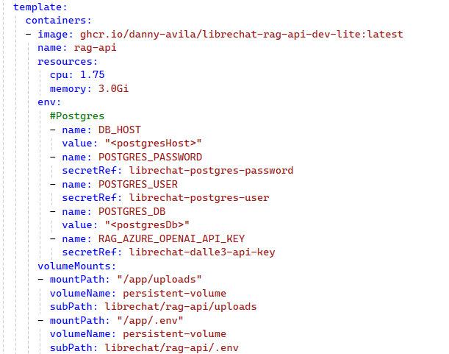
Familiar YAML
Can start from K8s YAML
Name & Image
Resource limits
Env variables
Volume mounts

Slide 24
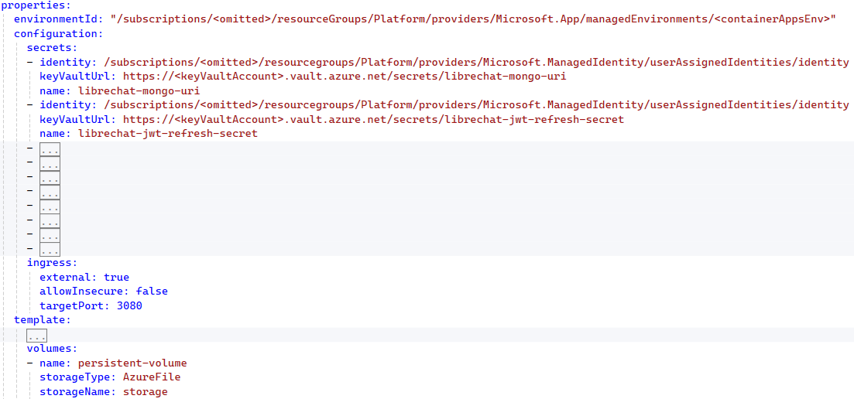
Simplified experience
Secrets management
Ingress configuration
Volume mounting

Slide 25


Slide 26
DEMO
Azure OpenAI experience

Slide 27


Slide 28
Takeaways
«AI at Work» should be the mantra
Start giving instruments, then teach them
Work to align your offering to the market
(nice to have) Choose appropriate technologies to reduce your governance around it

Slide 29



Valuta la sessione
GRAZIE!

